Slide 1

Disable Server Manager auto start
QuickTip

Slide 2
Possible methods
From the Server Manager properties (manual)
From the Task Scheduler console (manual)
Using Powershell (automated)
Using Group Policy (automated)
Work on Windows Server 2012/2012 R2/2016/2019

Slide 3
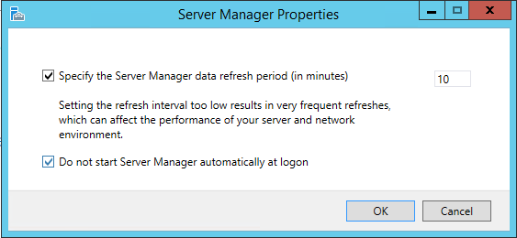
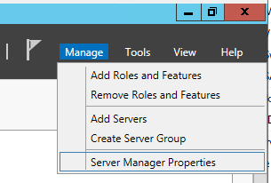
Server Manager properties
Notes:
Server Manager properties:
- Go to Manage and select Server Manager properties
- Check the ‘Do not start Server Manager automatically at logon’ box

Slide 4
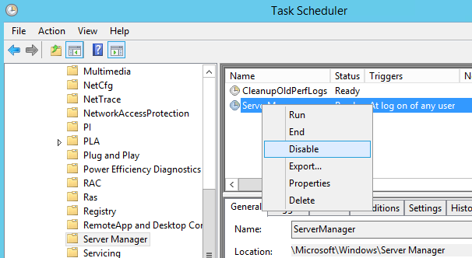
Task Scheduler
Notes:
Task Scheduler:
- Open the Task Scheduler MMC console
- Navigate to: Task Scheduler Library\Microsoft\Windows\Server Manager
- Right click on the ServerManager task and disable it

Slide 5
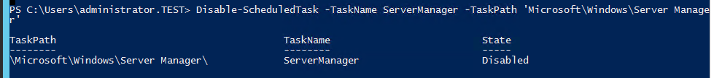
Powershell
Disable-ScheduledTask -TaskName ServerManager -TaskPath 'Microsoft\Windows\Server Manager’
Notes:
Powershell:
- Just run the command above and the scheduled task will be disabled (you can use Powershell remoting to execute the command on more servers)

Slide 6
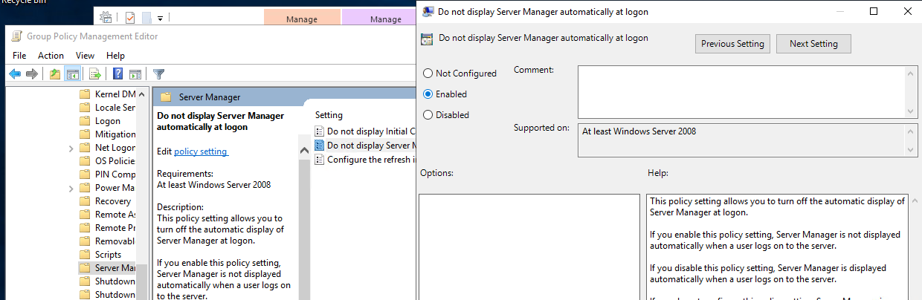
Group Policy
Notes:
Group Policy:
- Open the Group Policy Management tool and select a GPO to edit
- Navigate to: Computer Configuration\Policies\Administrative Templates\System\Server Manager
- Open Do not display Server Manager automatically at logon
- Select Enabled

Slide 7
https://www.youtube.com/channel/UCcZ-jLbPwNr8E_v9-65n8Iw https://github.com/itknowledge4

